Slide 1

Raspberry Pi Projects
Michael L. Kelley Jr.
Canon-McMillan School District
kelleym@cmsd.k12.pa.us

Slide 2
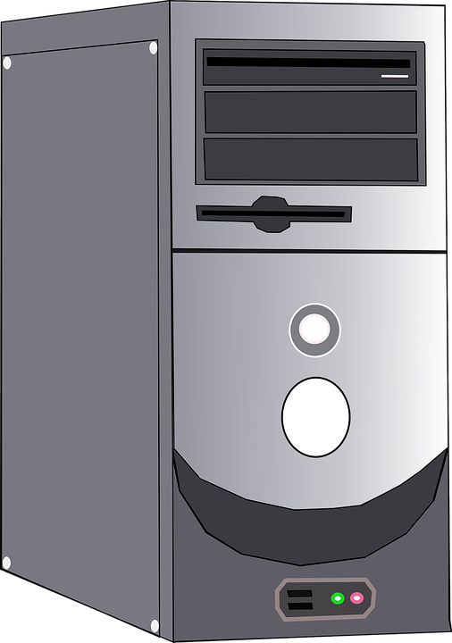
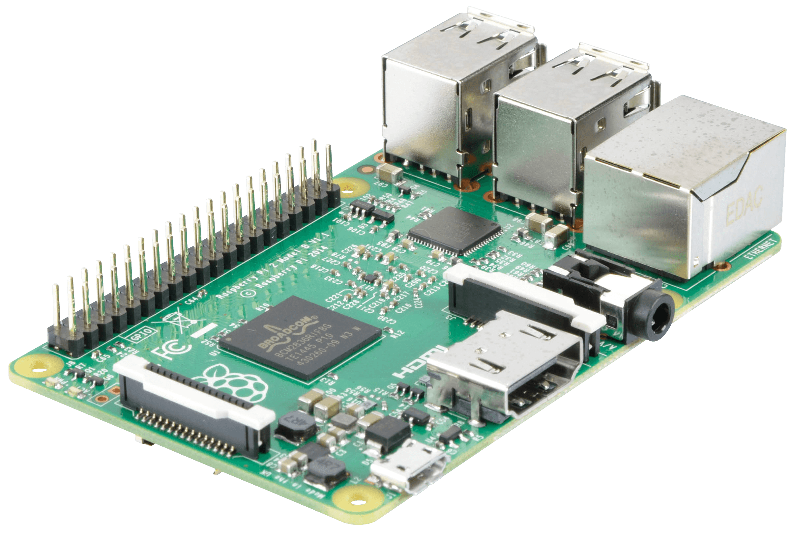
Why Raspberry Pi?
Powerful learning experience in a small, affordable package.
= =
“The Lego of computers”
Projects! Projects amplify the Pi and create many uses for it.

Slide 3
Internet of Things
Affordable, faster internet + affordable hardware = MAKE all the things!!!
Raspberry Pi - microcomputer that can run a full operating system (Usually Linux) and set of applications.
Arduino boards - microcontroller kits to build interactive objects that can sense things and also to build devices that can be controlled.
https://www.mepits.com/project/236/DIY-Projects/12-Best-Development-Boards-for-DIY-Projects - Other types of boards.
Internet of things (IoT) - Network of physical objects (Phones, computers, vehicles, watches, appliances, health monitors, etc.) that contain software, sensors, and network capabilities allowing them to collect and share data with one another.

Slide 4
Raspberry Pi
With a Pi, you can carry out many functions as a normal sized computer such as:
Programming
Photo editing
Web browsing
Games such as Minecraft, etc.
Desktop publishing (Google Docs/Programs similar to Word, Excel, Powerpoint, etc.)
Audio recording
Video and audio playback

Slide 5

Sample Project - RetroPie

Slide 6
RetroPie
The RetroPie project turns your Raspberry Pi into a small arcade machine.
Play vintage video games from systems like Nintendo, Super Nintendo, Sega Genesis, Nintendo 64, Atari 2600, arcade machines, and many others.
Project only takes about an hour or so, but it can be highly customized afterwards.

Slide 7
What will you need? (30 min. - 1 hr.)
Raspberry Pi 2
Micro SD card (You might want to use an extra)
USB flash drive
USB Keyboard + mouse
Display w video cable (TV w HDMI, Computer monitor w HDMI > VGA)
USB gamepad (Xbox 360 controller, other gamepad)
Game ROM files
Another computer to work from (To setup SD card)

Slide 8
General Process
Download the image file for your Raspberry Pi at: https://retropie.org.uk/download/
Use Win32 Disk Imager to write the file to your micro SD card: https://sourceforge.net/projects/win32diskimager/
Place the SD card into the Pi, Connect a controller and boot up the Pi.
Plug a USB flash drive into the Pi and wait for it to stop blinking.
On the other computer, copy ROM files over to the USB flash drive. Then plug it back into the Pi and wait for it to stop flashing again. This copies the games over.
Setup controller and play!

Slide 9
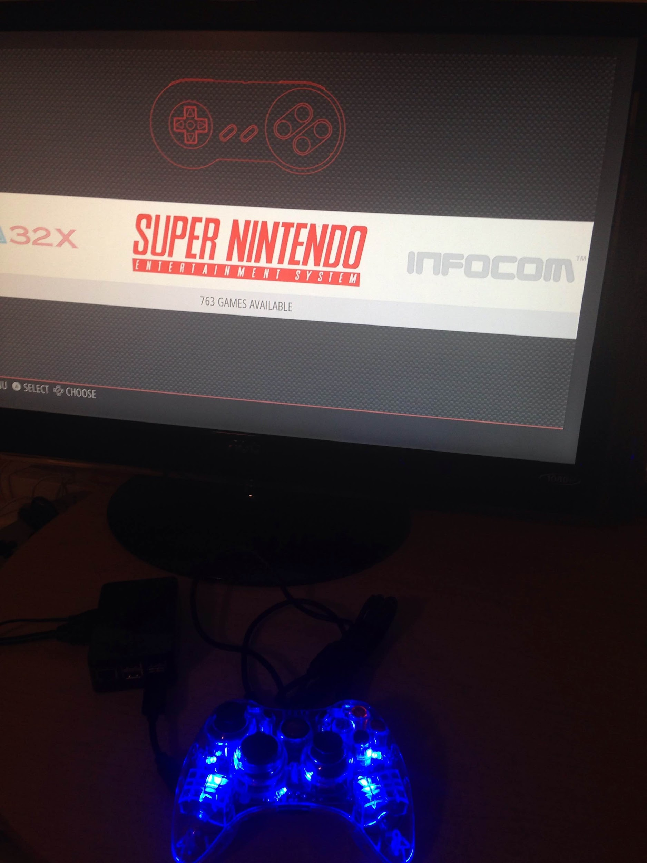
Success!

Slide 10
Note:
Some of the following projects require the purchase of additional hardware.
The Pi can work together with the Arduino and other boards. (Remember IoT)
Pricing would vary depending on project needs. (Cheap: RetroPie - Expensive: Espresso machine)
Please consult with the project instructions to make sure you have all items that are needed before starting out.

Slide 11
Pi Accessories
The Pi can use accessories like:
Camera module or USB webcam
GPS module - https://www.adafruit.com/product/2324
Accessory boards like:
Gertboard - https://www.sparkfun.com/products/11773
Laika Explorer board - http://www.project-laika.com/about-laika
These boards add things like switches, LED lights, motors, and sensors to the Raspberry Pi.

Slide 12

Chrome OS
Turn your Raspberry Pi into a Chromebox.

Slide 13
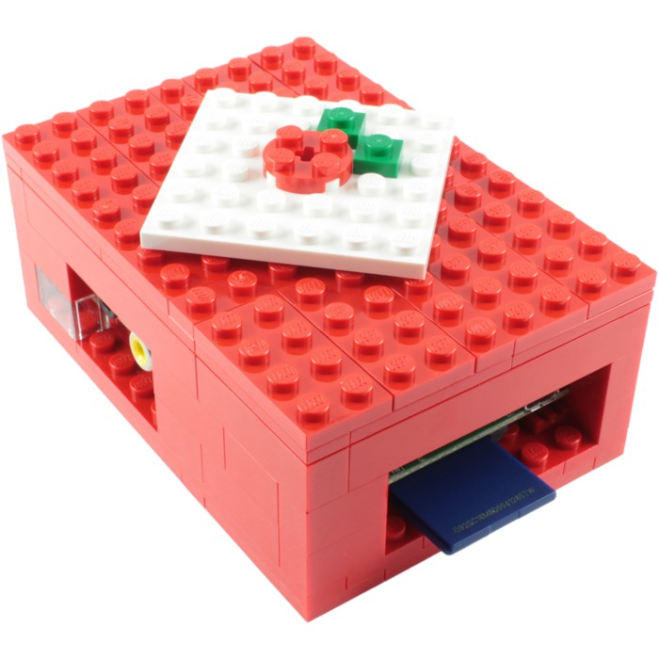
Make a Custom Case
Make a case out of:
Legos
Hollow Book
Cardboard
3D print a case
Many templates/designs available online.
Make it into a contest!

Slide 14
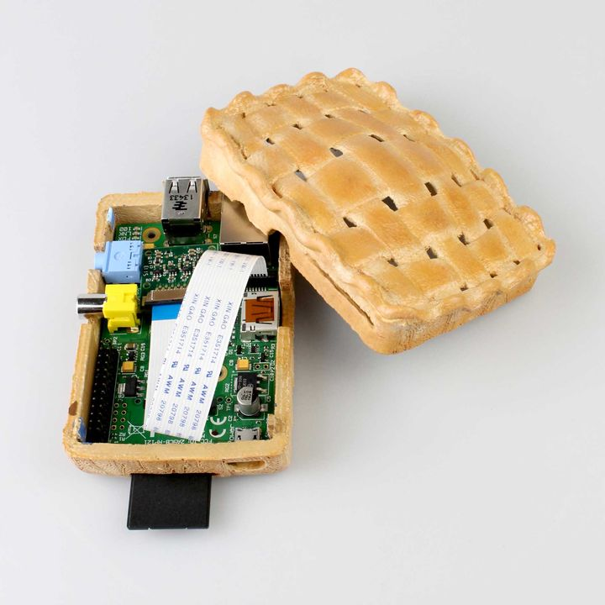
Cases (Cont’d)

Slide 15
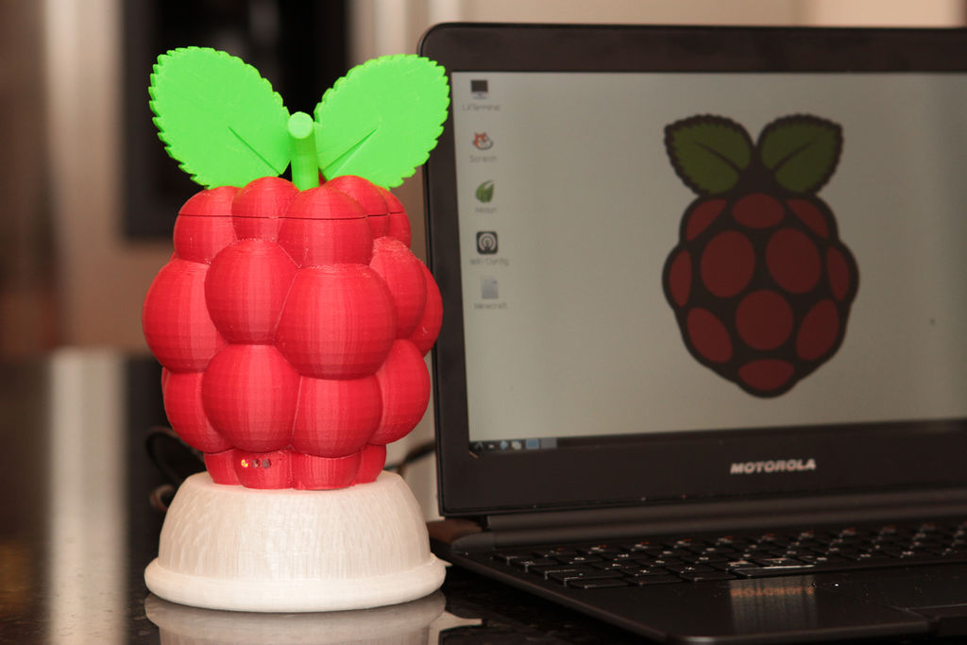
Cases (Cont’d)

Slide 16
Media Streaming Center
Create a media streaming center
Hook your Pi to an external USB hard drive that has music, movies, and files on it.
Use software like Plex, Kodi, or others to give your devices (Laptops, desktops, tablets, and phones access to stream the files that are on the Raspberry Pi)
http://www.htpcguides.com/install-plex-media-server-on-raspberry-pi-2/

Slide 17
Learn to Code
Learn programming on the Raspberry Pi with:
Scratch
Python
HTML
Python + HTML for web design = $$$
C
And various other languages.

Slide 18
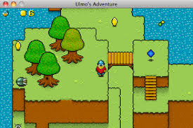
Coding a Game using Pygame
Use Python with Pygame to create a game.
http://www.pygame.org/

Slide 19
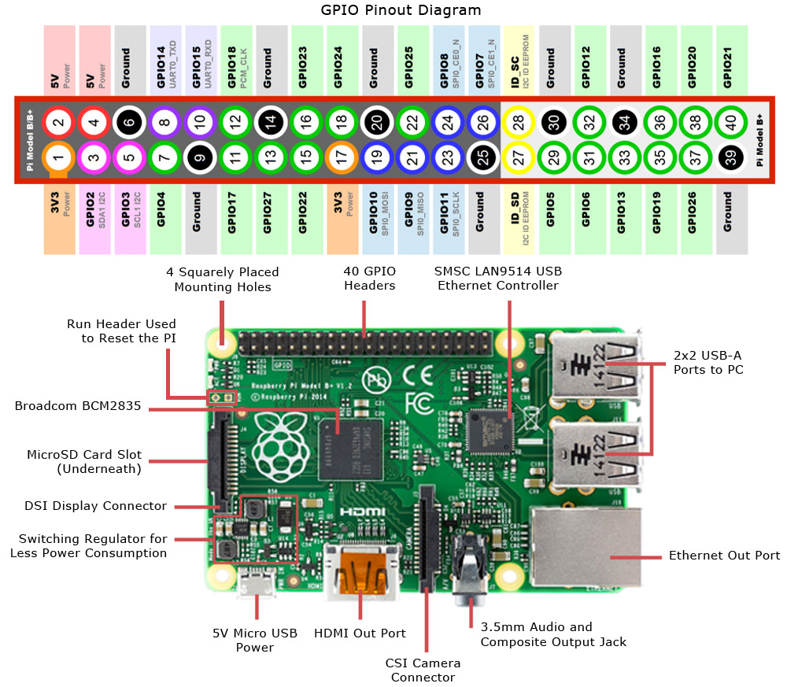
Teach Computer Hardware

Slide 20
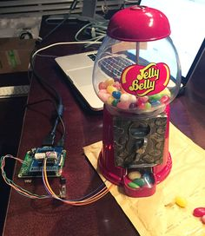
Pi Candy Dispenser
http://www.instructables.com/id/Raspberry-Pi-Twitter-Candy-Bot/

Slide 21
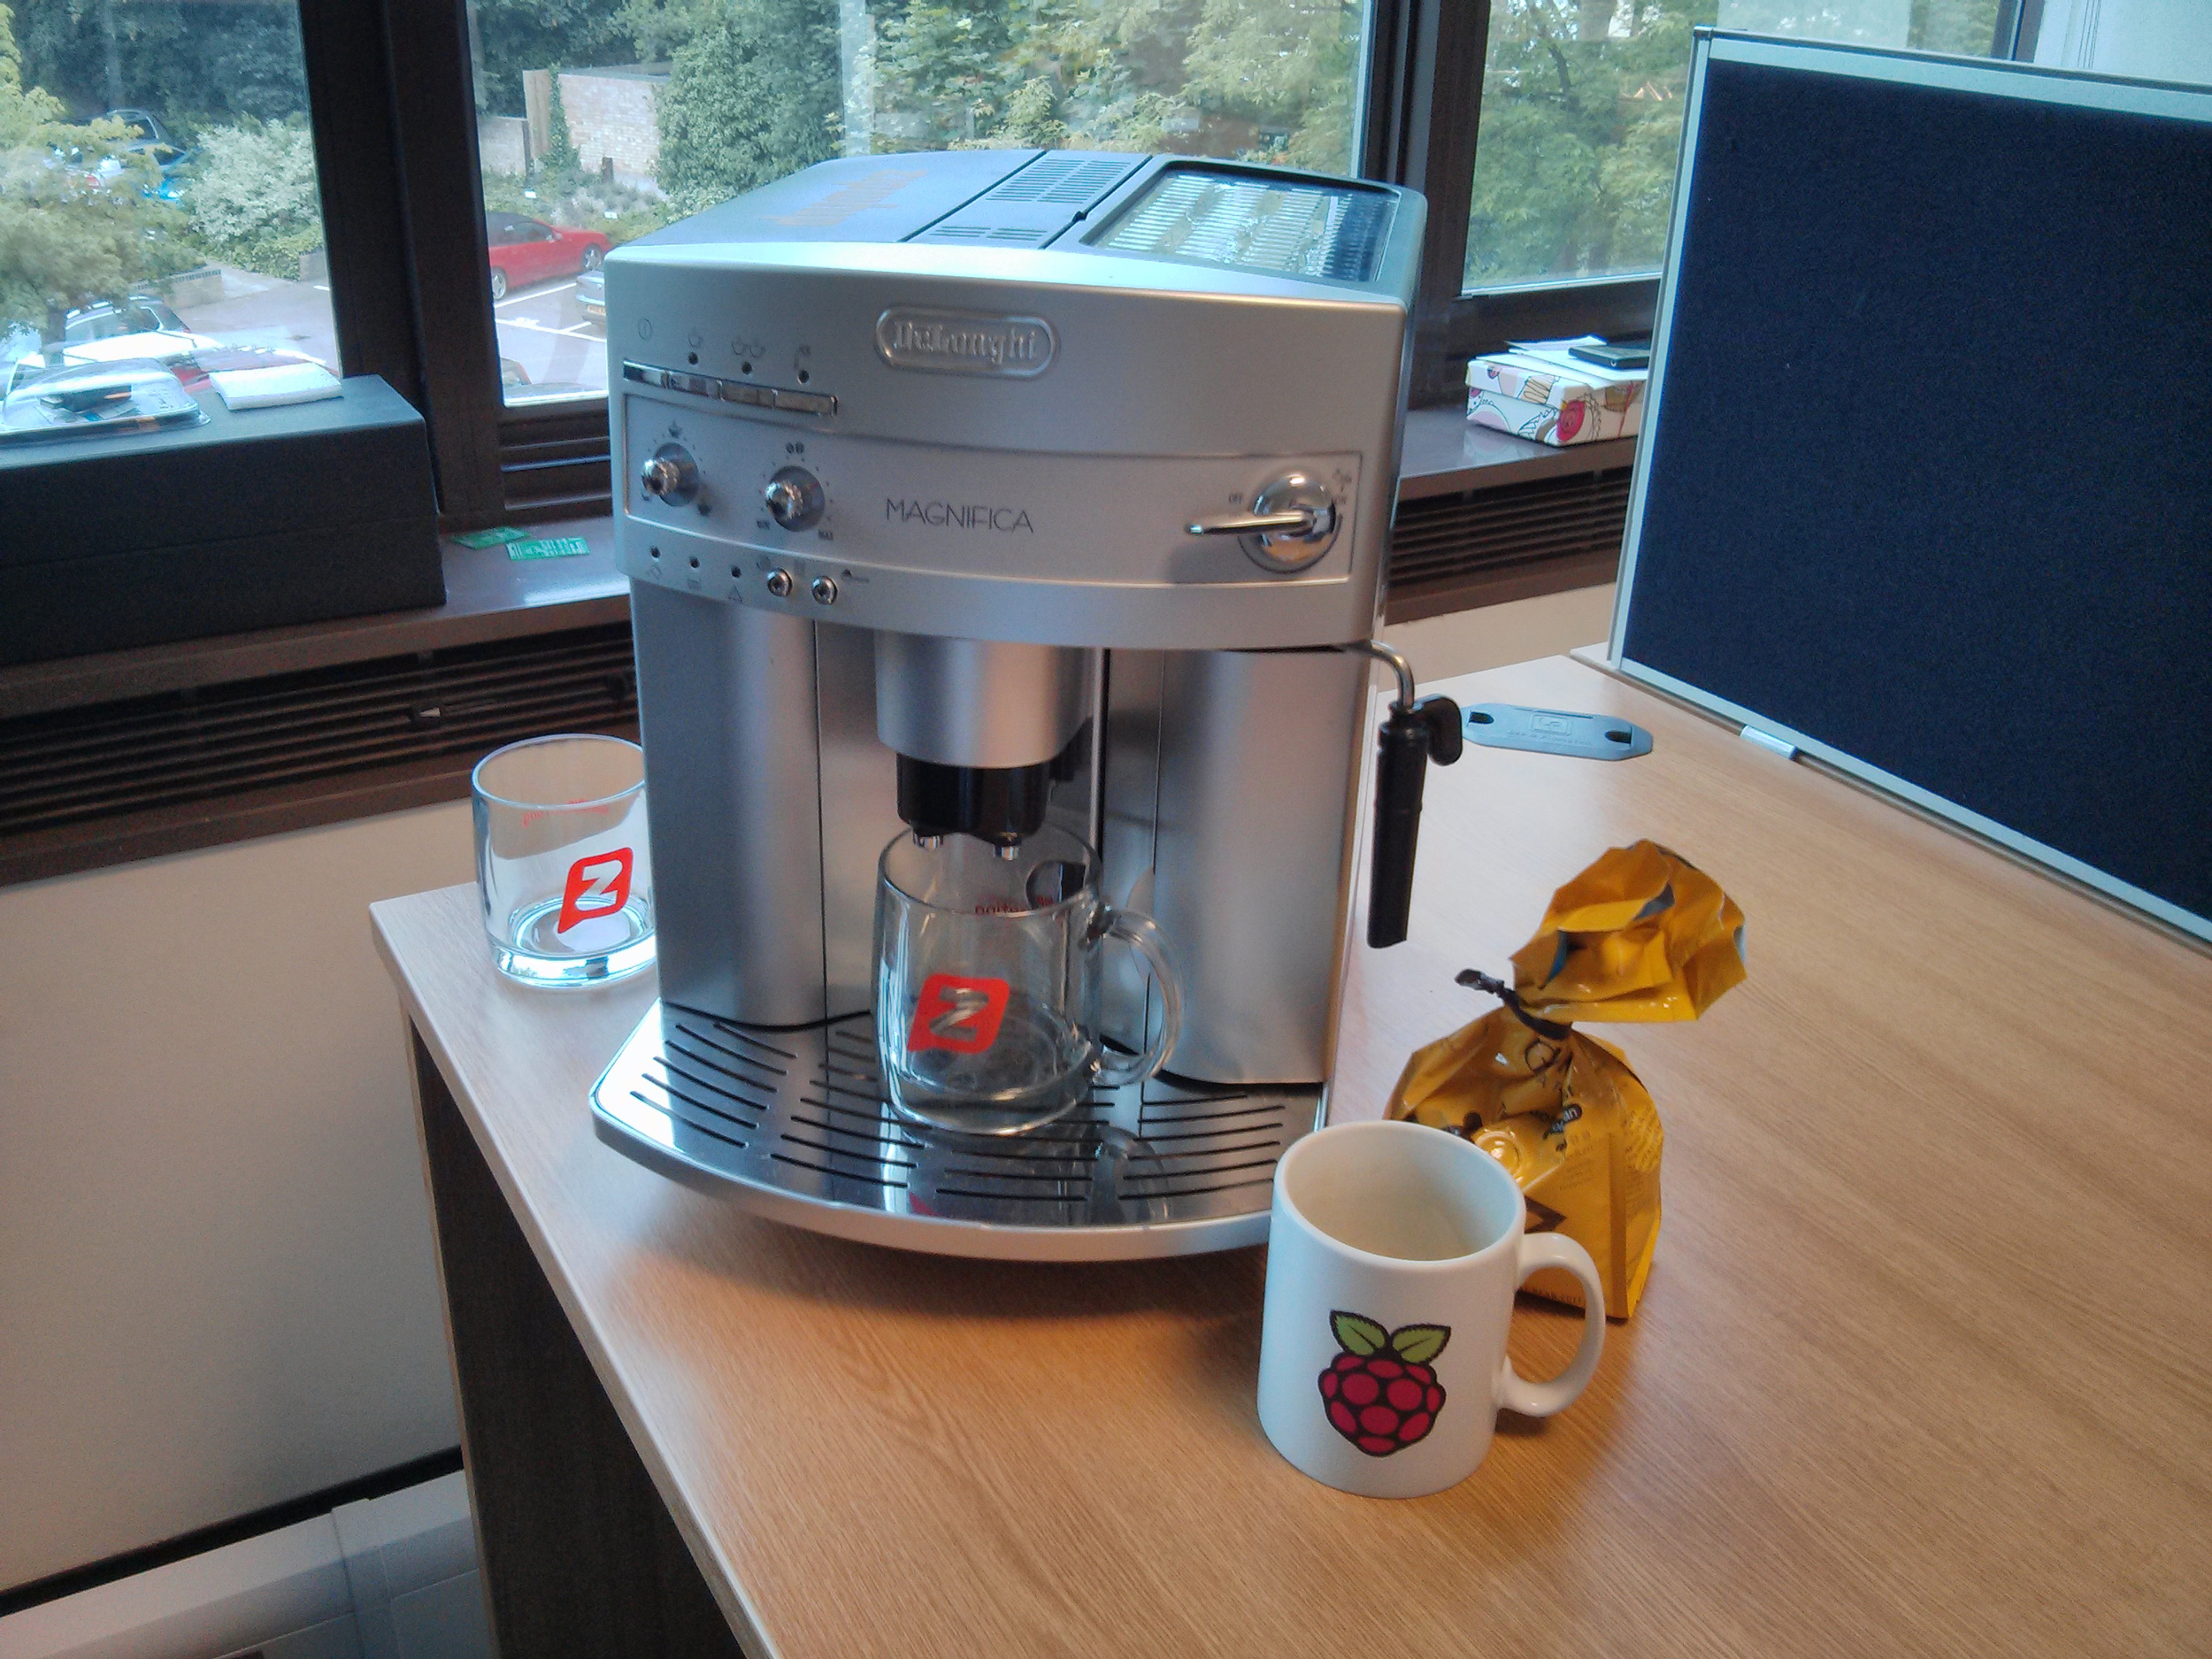
Cloud Texting Enabled Coffee Machine
https://www.raspberrypi.org/blog/not-that-sort-of-java/

Slide 22
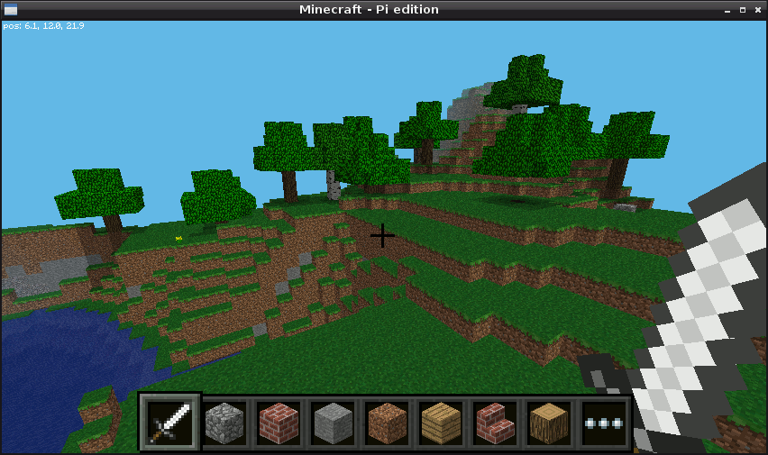
Minecraft Pi
Play and mod the popular game Minecraft included on the Raspberry Pi
https://www.raspberrypi.org/learning/getting-started-with-minecraft-pi/

Slide 23
Mathematica
An individual license for home use runs $300 per year, but it is included free of charge on Raspberry Pi.
A type of programming language to work with and manipulate data with mathematical functions.
Data science / research
https://www.wolfram.com/language/elementary-introduction/preface.html

Slide 24
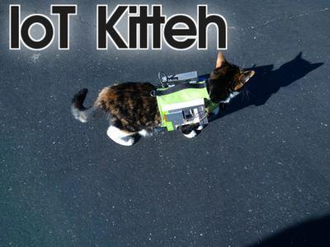
Tracking Collar/Vest
https://www.youtube.com/watch?v=DMNSvHswljM

Slide 25
Other Project Ideas
GPS tracking unit for vehicles, etc
Weather monitor
Picture frame / Calendar viewer
Automated animal feeder
Internet radio machine
WIFI extender
Security or wildlife camera
.

Slide 26
Slides
These slides are available at:
http://bit.ly/1UEw9WM

Slide 27
Resources and Learning Materials
https://www.raspberrypi.org/resources/
https://www.raspberrypi.org/magpi/
http://www.alphr.com/raspberry-pi/raspberry-pi-2/1000043/raspberry-pi-2-18-of-the-best-projects-you-can-try-with-the
https://www.adafruit.com/
https://www.sparkfun.com/
https://www.seeedstudio.com/

